Slide 1
Tavern Table
Group 7
Notes:
Jon - Intro

Slide 2
Members
Jonathan White
Sarah Thompson
Susan Long
Imahd Khan
Arisa Kitagishi
Fernando Bilbao
John Balbuza
Notes:
All :-)

Slide 3
What is our project?
'Tavern Table'
Dungeons and Dragons (DnD) App
Can be a Dungeon Master or a player on a game-by-game basis
Tracks character statistics, equipment, and abilities
Maintains Character Sheets Publicly
Web-based character/campaign manager
Notes:
Sarah

Slide 4
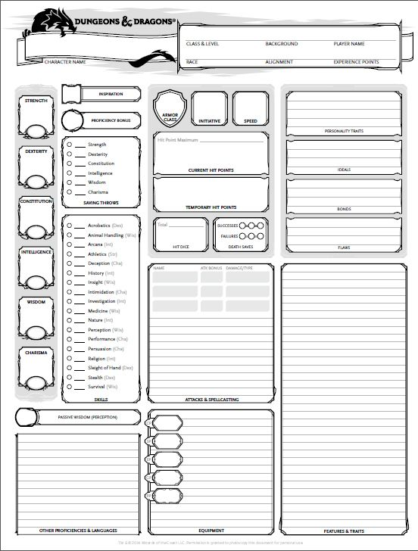
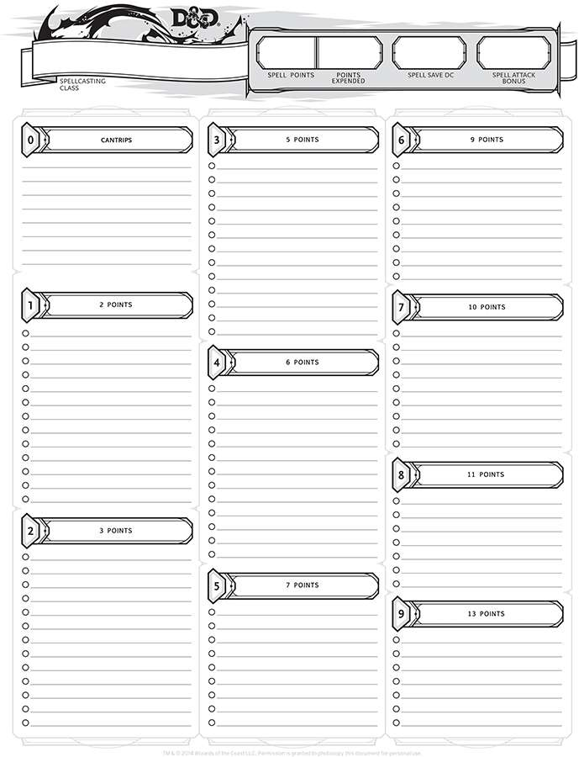
Notes:
Susan

Slide 5
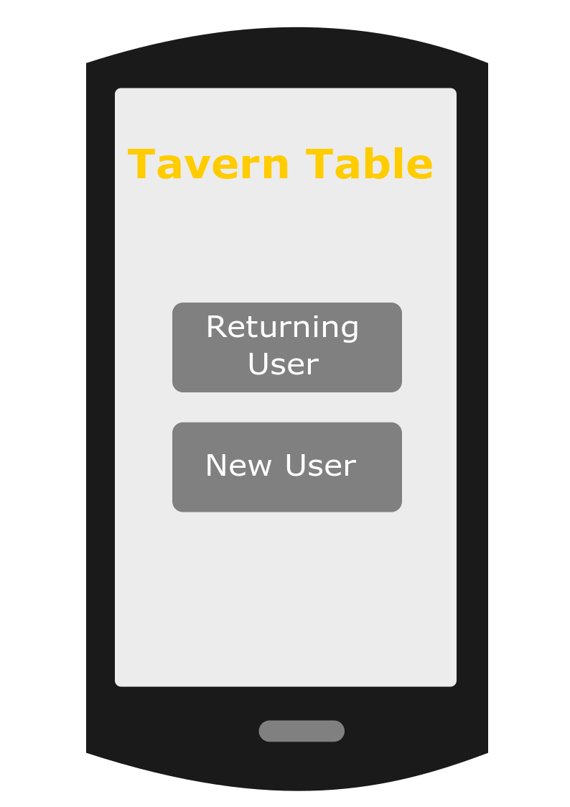
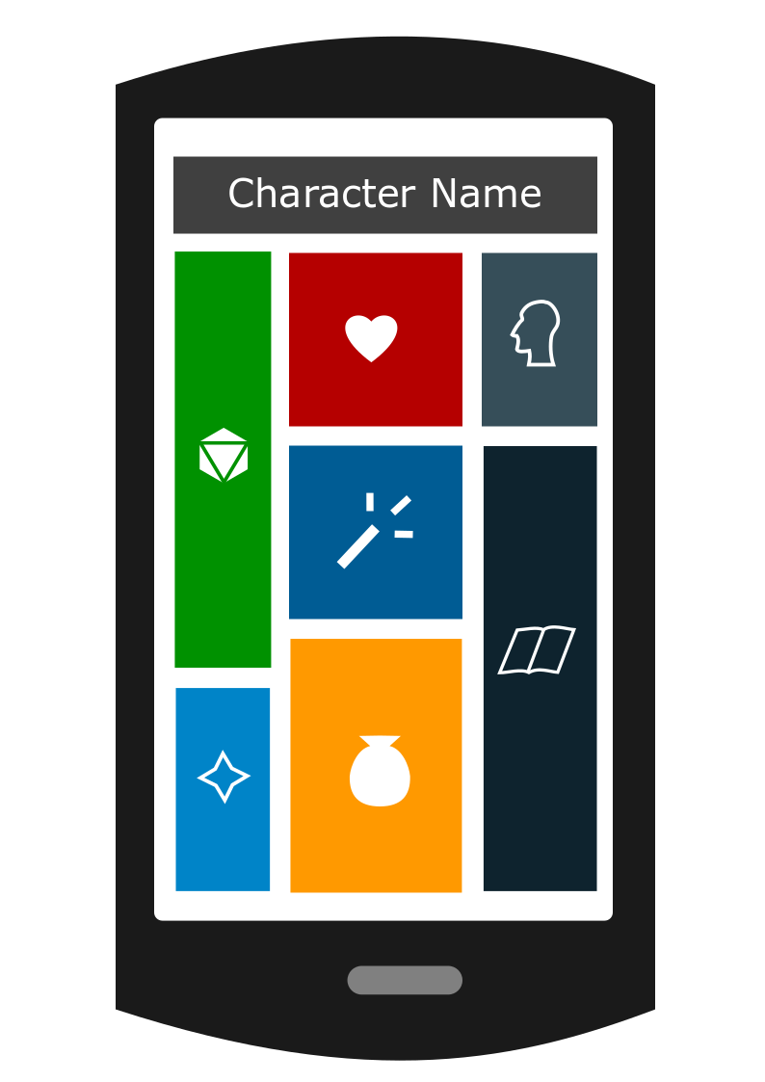
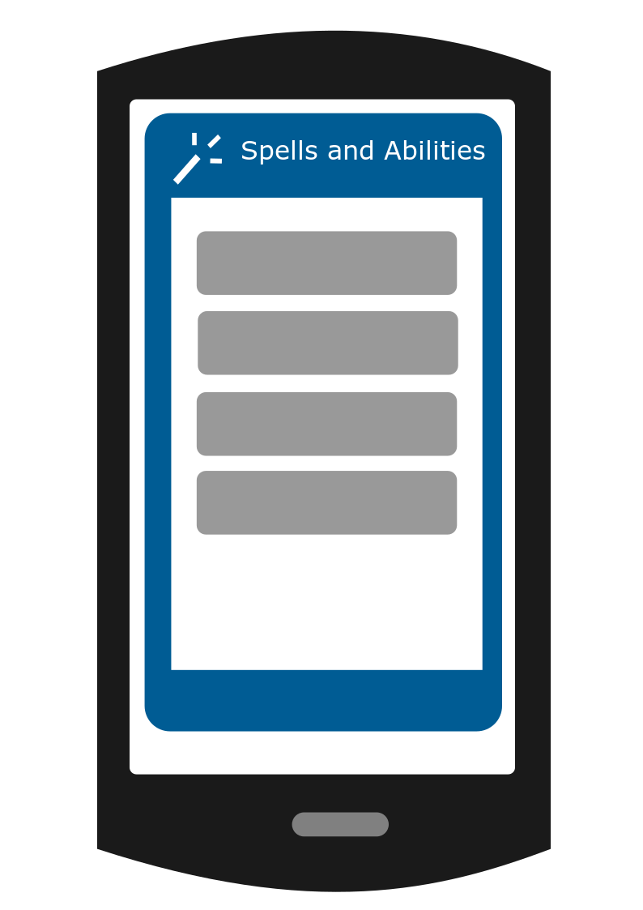
Mock-up App
Notes:
Jon

Slide 6
Motivation
Surge in Popularity
Busy adults can't often meet up for games at the same time
Often difficult to set aside time for long sessions
Too many details to keep up with
Easier communication
lots of time lost asking questions
Players and Dungeon Masters can't see others' information
Minimizes pressure on the Dungeon Master
Efficient gameplay
It’s fun!
Notes:
Fernando

Slide 7
Expected Challenges
Inexperience with Android
Inexperience with DnD
Scale of project
Very data driven
Many connections/references between data points
How much flexibility to give users?
How to organize work?
Notes:
Imahd- Whole Side

Slide 8
What Will it Take to Complete the Project?
Tools
Android Studio
Amazon Web Services
PHPMyAdmin
Inkscape
Discord
Project organized into 3 phases
Build UI
Build game logic
Implement communication features
Notes:
Arisa

Slide 9
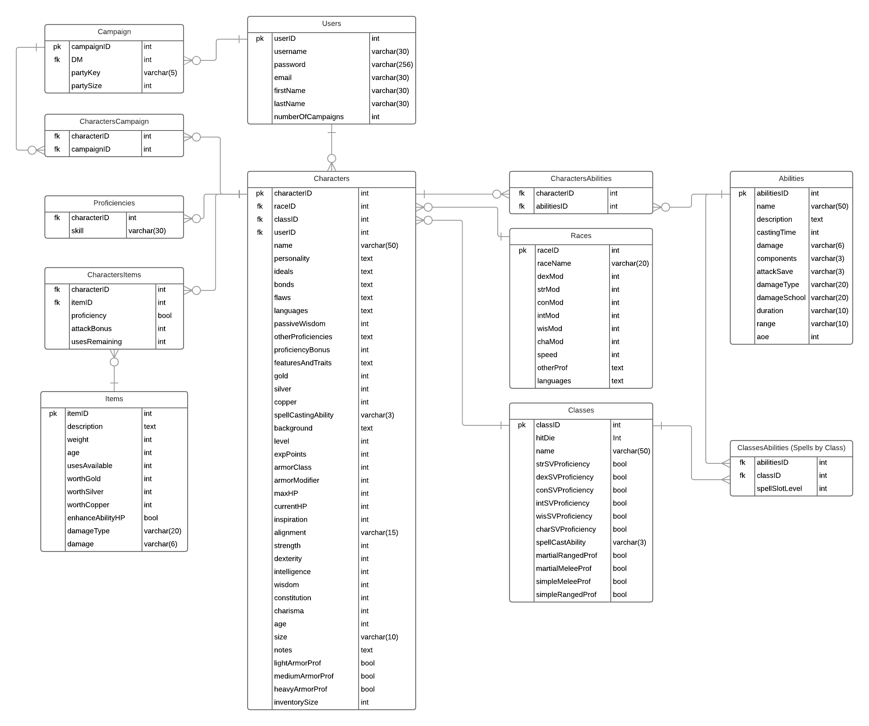
ERD
Notes:
John

Slide 10
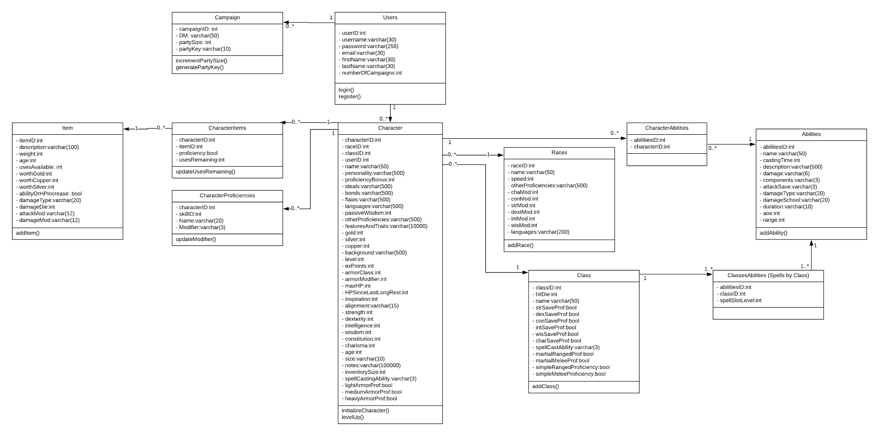
Class Diagram
Notes:
John (?)

Slide 11
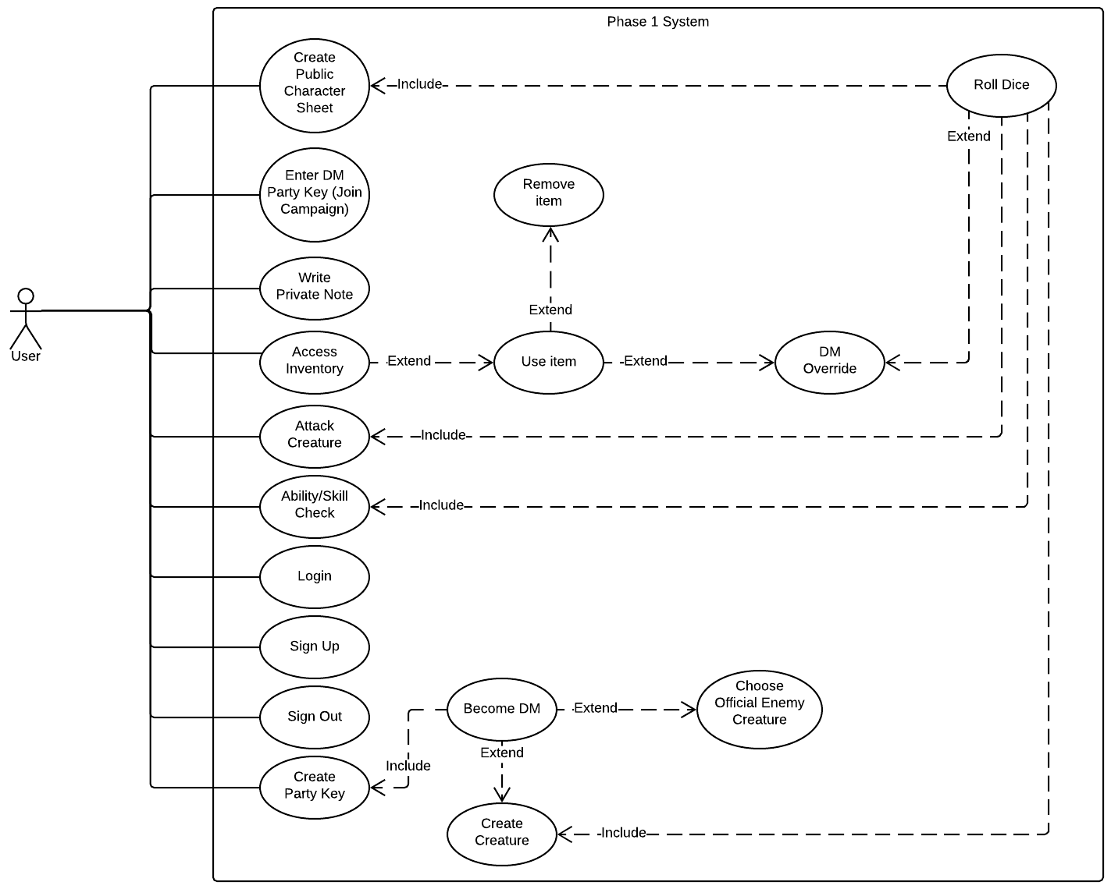
Use Case
Phase 1
Notes:
Susan

Slide 12
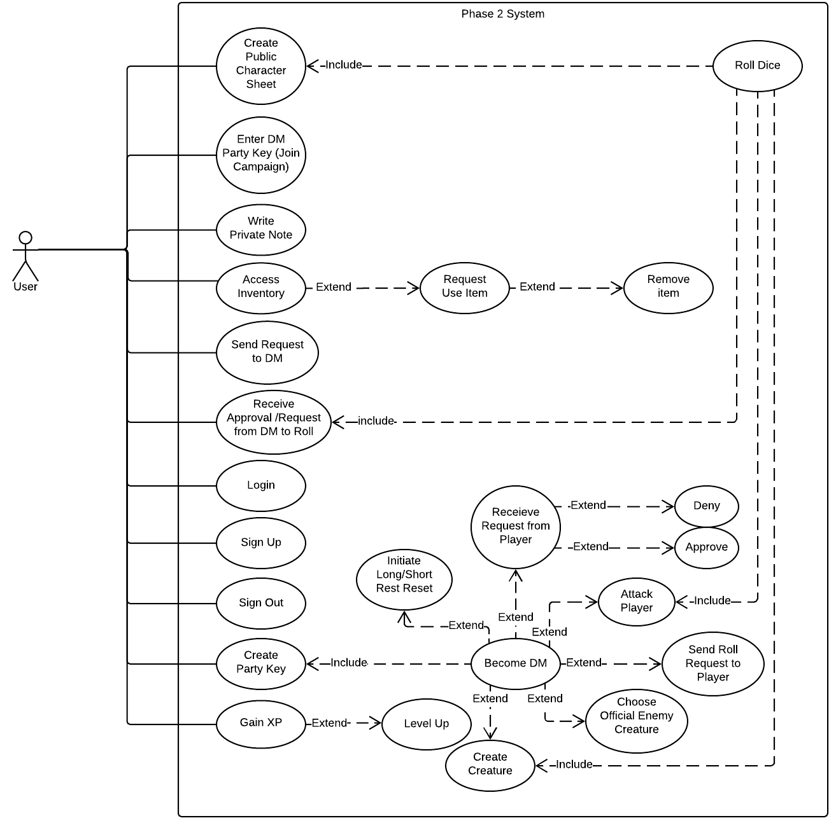
Use Case
Phase 2
Notes:
Susan

Slide 13
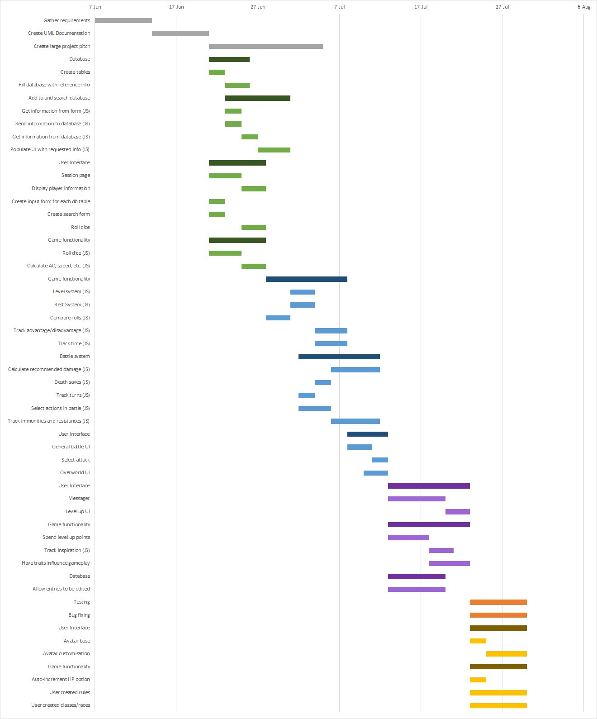
Gantt Chart
Notes:
Jon

Slide 14
Gantt Chart
Notes:
Jon

Slide 15
Gantt Chart
Notes:
Jon

Slide 16
Gantt Chart
Notes:
Jon

